Slide 1

How To Make Money Fast Using A PBX
PWNED
Patrick McNeil
@unregistered436

Slide 2

No books

Slide 3

No videos

Slide 4

No infomercials

Slide 5

No high pressure sales

Slide 6

No investment

Slide 7

Phase 1 Phase 2 Phase 3
Pwn PBX ? Profit!!
Notes:
I’m going to show you, after you’ve Pwned the PBX, what the unknown element is to create Profit!

Slide 8

Mandatory Disclaimers and Legalese
Views and opinions are my own and not those of any past or present employer.
This presentation is solely for academic and educational purposes. Don’t be a dick.
All Service Marks, Trade Marks, and Copyrights belong to their respective owners.
Notes:
http://memegenerator.net/Joseph-Ducreux

Slide 9




Why listen to me?
Worked here almost 10 years
Solutions architect here
Four years at voice security company acquired by Oracle
Now solutions architect
Notes:
You don’t need to know my Bio. You’re hackers, Google me.

Slide 10
Yes, you CAN make money fast
Voice Fraud accounted for $46.3B of losses in FY2013, up 15% from 2011
-Communications Fraud Control Association (CFCA) 2013 survey
Notes:
AT 3 min

Slide 11
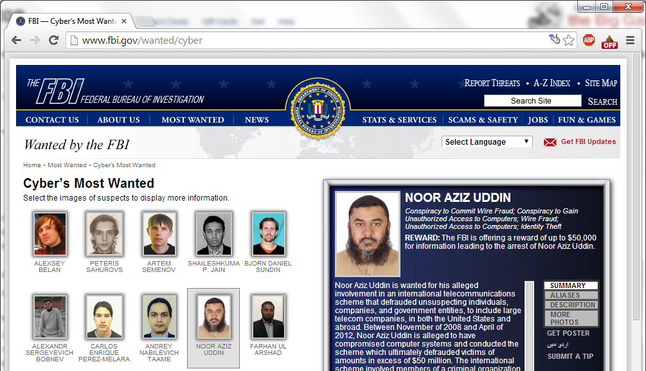
US LEOs take notice
In Nov, 2013 the FBI added two phone fraudsters to the Cyber Most Wanted

Slide 12

Here’s how the story goes…
How we got here
Why bad stuff is so easy
How PBX cracking happens and who does it
If you had a cracked PBX and wanted to use it …
How To Make Money Fast
Notes:
At 4 min

Slide 13
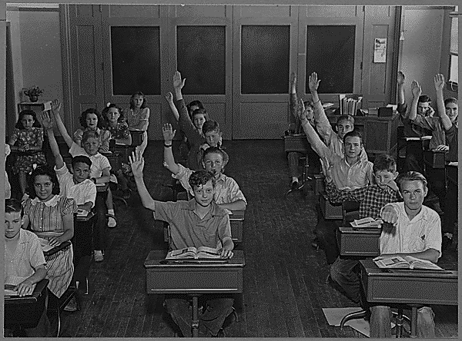
Cliffs Notes History lesson…

Slide 14
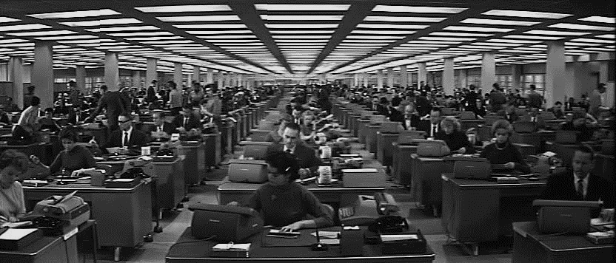
In modern offices everyone needed a phone, but that’s expensive if it’s from the phone company.
A Private Branch Exchange system was a way to share limited resources and also allowed users to call each other without the phone company.
Still lots of wires & lots of maintenance
Notes:
IP PBX – Internet Protocol based Private Branch Exchange business telephone system designed to deliver voice or video over a data network and interoperate with the normal Public Switched Telephone Network.

Slide 15
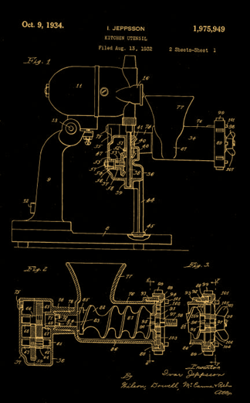
Along comes IP… and we mixed voice and data, connecting to the Internet.
First popular with H.323 / RTP
Now dominated by SIP / RTP
Carriers ‘peer’ SIP now and TDM / copper being retired

Slide 16
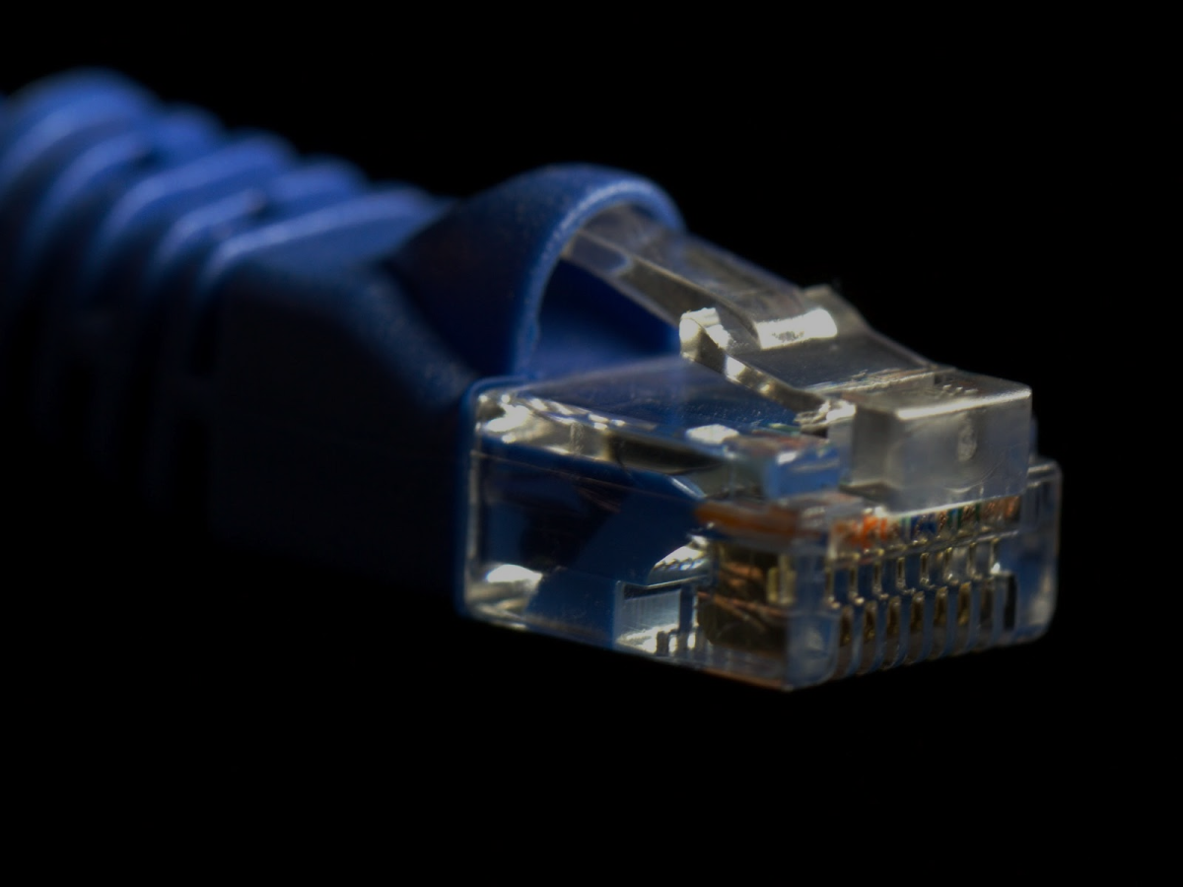
The move to IP based PBX
Cash savings, mobility, and features!
Internet enables
“Trunking” to your choice of provider from local PBX (Asterisk / FreePBX / Trixbox, Cisco, Avaya, Lync, etc)
Cloud PBX services
SIP enabled “hard phones”, soft clients, & Integrated Access Devices (IAD)
Remote admin
Have to connect to benefit – uh oh

Slide 17

I am Sooo messed up,
But that’s nothing compared to SIP …

Slide 18
SIP is cleartext…
INVITE sip:19195551212@skynet.net SIP/2.0
Via: SIP/2.0/UDP 10.1.3.3:5060;branch=z9hG4bKb27061747269636b
From: “JConnor“ <sip:15554141337@10.1.3.3:5060>;tag=18de4db33f
To: "19195551212" <sip:19195551212@skynet.net>
Call-ID: 19424e0d9187654209ed34db33f
CSeq: 1 INVITE
Max-Forwards: 70
User-Agent: BigTelcoVendor/R16.4.1.1
Supported: 100rel,timer,replaces,join,histinfo
Allow: INVITE,CANCEL,BYE,ACK,NOTIFY,REFER,OPTIONS,INFO,PUBLISH
Contact: “JConnor" <sip:15554141337@10.1.3.3:5060;transport=udp>
Content-Type: application/sdp
Content-Length: 165
v=0
o=- 1 1 IN IP4 10.1.3.3
s=-
c=IN IP4 10.1.3.3
b=AS:64
t=0 0
m=audio 19001 RTP/AVP 0 127
a=rtpmap:0 PCMU/8000
a=rtpmap:127 telephone-event/8000
SIP
SDP
Media description
Notes:
Signaling is the messaging exchanged to set up and control communications. Since Session Initiation Protocol or SIP is the most common we’ll be looking at it here. Message exchanges are expressed in clear text as shown in the example on this slide.
This shows some SIP signaling, and is an Invite or initial connection message. The Invite is trying to establish a voice stream negotiated using Session Description Protocol or SDP.
Because the message is in clear text it’s open to manipulation and it’s easy to write your own programs ….

Slide 19
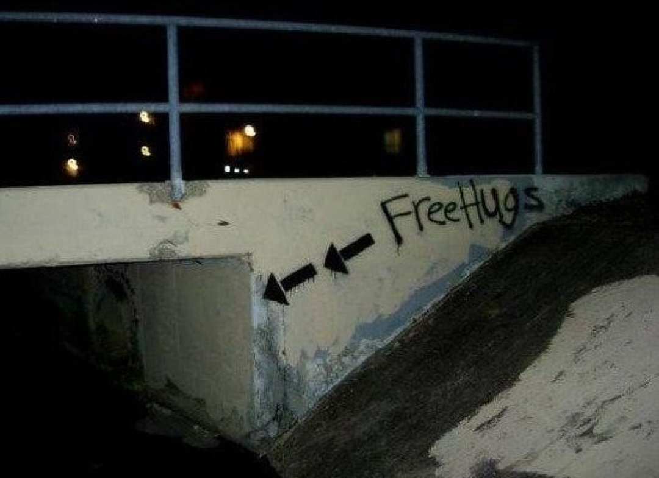
Honeypots for data collection…
Notes:
Inspired by Chris Tedorski’s talk at CarolinaCon #7 on SSH honeypots, set up at end of 2011

Slide 20
So I set up a honeypot at a major University …
Dionaea Honeypot with SIP (TCP, UDP, TLS) and TFTP
No trunk to a provider (no $$!)
Built dial-plan based on “interesting” numbers (financial aid, bursar, security, etc)
Plenty of probes, but no extension enumeration scans
Updated to include commonly scanned numbers
Surprising Results
No attacks to TCP
No attacks to TLS for over a year
No attacks to TFTP
Only three digit extension checks
Top tool used reports no data if extension doesn’t match

Slide 21
SIP Method Types Seen
OPTIONS sip: pbx.example.com
Health check / capabilities
INVITE sip: 5551212@pbx.example.com
Establish a call
REGISTER sip: pbx.example.com
Establish authorization and
binding in registrar
(trust me, I’m real! ☺)
There are actually fourteen SIP methods, but we see these three most often in attacks.
Notes:
SIP is a signaling protocol used to establish and manage sessions. It’s clear text, so we can easily examine it using a protocol analyzer, and it’s easy to write programs that use it.
There are fourteen standard SIP methods or actions that can be taken, but we see three initial methods used as part of fraud.
OPTIONS – for health checks and capabilities exchange – i.e. what can you support
INVITE – establish a call from and to
REGISTER – establish authorization to make calls and where you can be reached (IP). This method commonly uses a password.

Slide 22

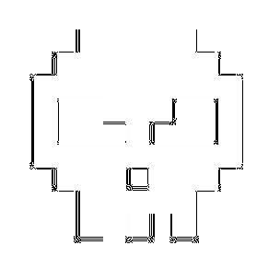
SIP attack playbook
Scan wide IP range with OPTIONS
INVITE to probe for an open system
REGISTER(s) to crack user credentials (md5 digest auth)
INVITE to known test number or “burner” phone
OPTIONS sip: 1.1.1.1
Internet
INVITE sip:100@1.1.1.1
PSTN
INVITE sip:901197259951234@1.1.1.1
REGISTER sip: 100@1.1.1.1
Password: 100
Password: 101
Password: 102
INVITE sip:0117259951234@1.1.1.1
INVITE sip:801197259951234@1.1.1.1
INVITE sip:901197259951234@1.1.1.1
Notes:
Attackers may target you and your IP range directly, but in general they’ll just ‘sweep’ a whole range of IP(s) with their scanner.
OPTIONS discovers whether something is listening
INVITE to check for an open service that will forward their calls without authorization
INVITE or REGISTER for multiple user extensions to determine what accounts are available
REGISTER to crack extensions with weak passwords
Start making calls. Sometimes they may not work if a dial prefix is needed, so they try all of those

Slide 23
A recent example…
84915 connect udp aa.bb.cc.dd:5060 37.8.60.139:10333
SipSession
84924 connect udp aa.bb.cc.dd:5060 37.8.60.139:10333
SipCall
method: 'INVITE' ['15cc96cbd91666cb1a659b7e62717201'] ('sipcli/v1.8')
addr: <900972597738881> sip:900972597738881@aa.bb.cc.dd
to: <900972597738881> sip:900972597738881@aa.bb.cc.dd
from: <100> sip:100@aa.bb.cc.dd
84922 connect udp aa.bb.cc.dd:5060 37.8.60.139:10333
SipCall
method: 'INVITE' ['d2cdb9b25633d0b837598508ab6a3c5c'] ('sipcli/v1.8')
addr: <810972597738881> sip:810972597738881@aa.bb.cc.dd
to: <810972597738881> sip:810972597738881@aa.bb.cc.dd
from: <100> sip:100@aa.bb.cc.dd
84916 connect udp aa.bb.cc.dd:5060 37.8.60.139:10333
SipCall
method: 'INVITE' ['c995784f5bd07515b910c41202dcbffa'] ('sipcli/v1.8')
addr: <000972597738881> sip:000972597738881@aa.bb.cc.dd
to: <000972597738881> sip:000972597738881@aa.bb.cc.dd
from: <100> sip:100@aa.bb.cc.dd
“Palestinian Internet Services” (ripe.net)
Jawwal Cellular, Palestinian Territories

Slide 24
SIP Attack Tools
Top Tools
SIPVicious aka “friendly-scanner” (previously 99%!)
VaxSIPUserAgent/3.1
Sipcli
eyeBeam (old cracked version)
Other user-agents of note
< 0.4% each
Nmap NSE
Metasploit
Sundayddr (worm)
Notes:
http://www.youtube.com/watch?v=FOHFnc8TmlA&feature=youtu.be&app=desktop
Data 1 YR period from 3/17/13

Slide 25
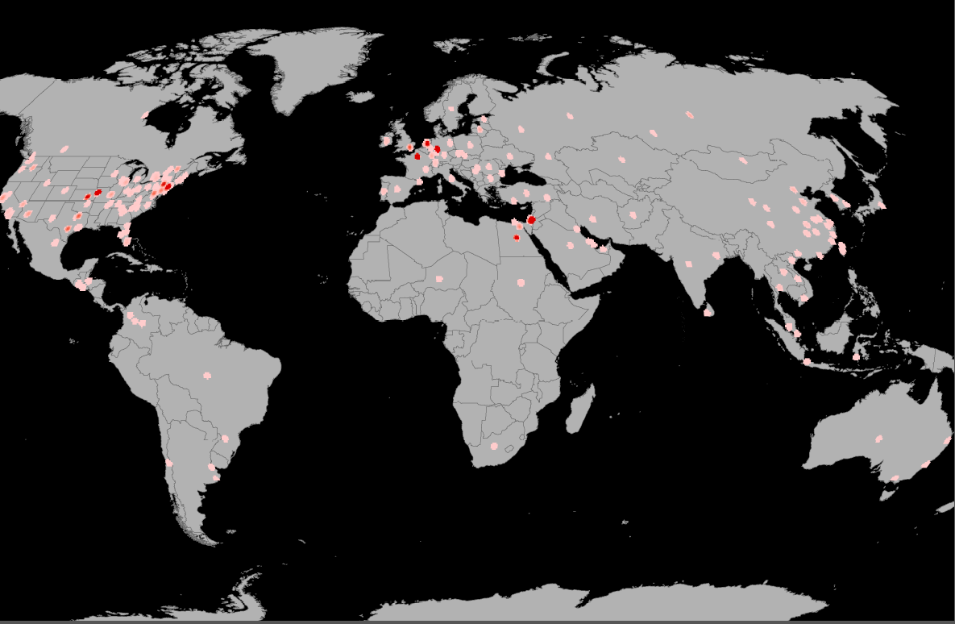
Top 6 Source Countries (GeoIP - # incidents)
20.3% (DE)
17.4% (FR)
35.7%
2013 – US 18% now 35.7%!
20.5% (PS)
72% in US from cloud / hosting providers
1.3% (IL)
2% (EG)
REAL attribution hard to prove
Top 6 sources > 97% of total 59
2013 – 65% Israel & Palestinian territories, 2014 - only 23%!
Map credit Dwight Otwell - Dotwell@tavlasolutions.com

Slide 26
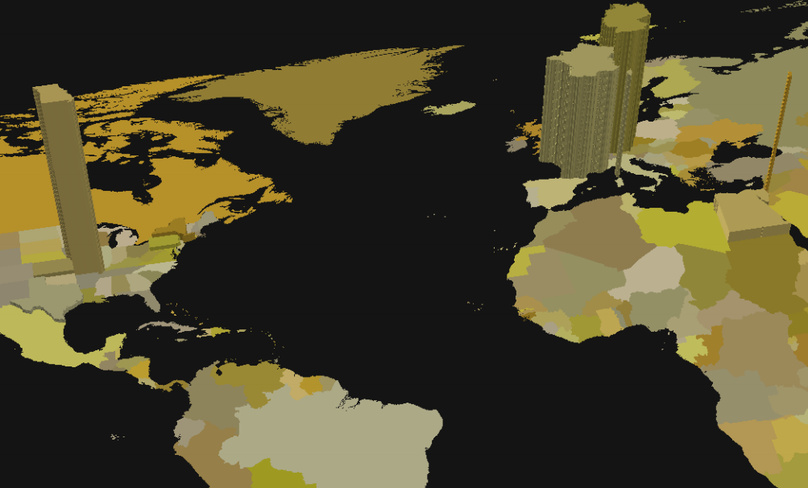
Traffic by volume shows a similar story
One REALLY persistent @#$% from a KC, MO cloud center gets the gold
Map credit Dwight Otwell - Dotwell@tavlasolutions.com

Slide 27

Discovery with SIPVicious
OPTIONS messages looking for open SIP port; INVITE(s) work well here too
Some manufacturers patched so they won’t respond to OPTIONS
./svmap.py 192.168.145.0/24
| SIP Device | User Agent | Fingerprint |
------------------------------------------------------------
| 192.168.145.132:5060 | FPBX-2.11.0(11.7.0) | disabled |
Notes:
Maybe you want to filter OPTIONS from ‘friendly-scanner’

Slide 28

Enumeration with SIPVicious
REGISTER or INVITE to see what error is returned to determine if extension exists
./svwar.py –D 192.168.145.132 –force –m INVITE
| Extension | Authentication |
------------------------------
| 100 | reqauth |
| 101 | reqauth |
| 105 | noauth |

Slide 29

Credential cracking with SIPVicious
Multiple REGISTER attempts using a specified user and passwords from a “dictionary” or pin range specified at runtime
./svcrack.py –u2000 –d worst-passwords.txt 192.168.159.133
OR
./svcrack.py –u100 –r0-9999 –z4 192.168.159.133
| Extension | Password |
---------------------------
| 101 | password123 |

Slide 30
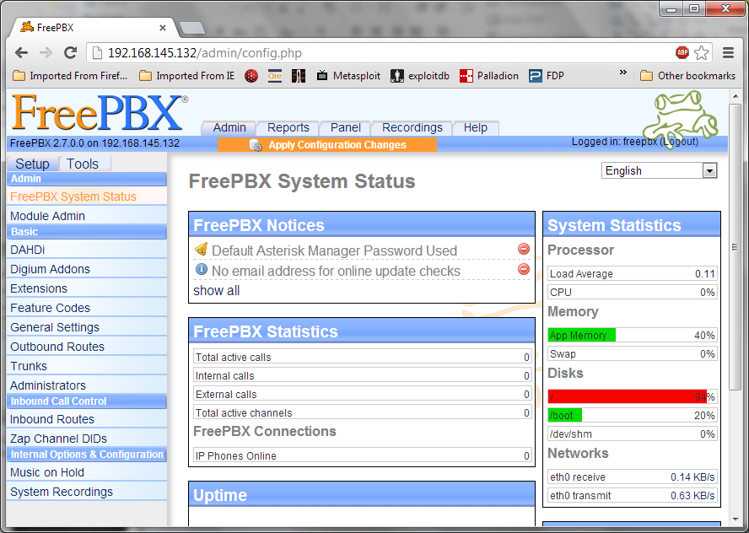
Admin interface targets
Web management, some with known vulns
Automation API(s) interfaces – REST, SOAP, AGI, etc
Notes:
Sometimes compromising the admin interface is as easy (or easier) than the SIP accounts.
Most IP-PBX have a telnet or ssh command line interface, many have a web interface, and some have an API used for automation with provisioning systems.
Fraudsters looking to compromise you will initially focus on default usernames and passwords then move on to SQL injection or other common vulnerabilities to get user credentials.
If those don’t work, vulnerable services or web code might be exploited to inject commands or an executable, usually which create a “shell” or command line interface back to the attacker and outbound through your firewall.
Some services run with high permissions levels, so if you can compromise them you’ll have a high permission level on the hosting box

Slide 31
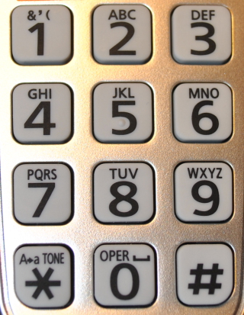
Old skool works too…
Audio prompts used to identify your voicemail system
Weak pin guessed (there are sweatshops for this!)
Once cracked, outbound-dial, call forwarding, or voicemail return used to make calls
What PIN patterns do people choose? Many are based on dates or patterns. http://bit.ly/1cZJIvI

Slide 32

Prevention
Generally small companies not following best practices get compromised
Reset ALL default passwords
Patch current
Filter international numbers and/or use outbound auth codes
Disable outbound dial from voicemail
Don’t use three digit extensions
Use an SBC or voice-specific security appliance
Detection - Call Detail Records ok, signaling monitoring better
Discuss fraud liability and/or prevention services from carrier

Slide 33
RESTRICTED AREA
NO UNAUTHORIZED PERSONNEL
BEYOND THIS POINT

Slide 34

Keys to successful fraud
Notes:
AT 26 minutes?

Slide 35

Timing
Do it during “off” time, like a weekend or holiday
Get paid weekly, before charges are noticed

Slide 36

Laws & contracts
Take advantage of high rates/price differences
Find scenarios where providers or customers are forced to pay
Notes:
http://www.ictregulationtoolkit.org/en/toolkit/notes/practicenote/3282

Slide 37

Location
Cross jurisdictional boundaries (countries) to make prosecution harder
Notes:
Smaller or developing nations have less sophisticated LEAs and may turn their head because of the income
Use of VoIP itself is actually illegal in the United Arab Emirates, Oman, Gambia, etc
Other countries regulate VoIP gateways – like India
Other countries like China you need to be a registered service provider to offer VoIP, so skype and other services are illegal.
Other countries just block it all…

Slide 38

Case Study: Meet Joe
Joe just cracked SIP credentials on an IP PBX with his l337 n00b SIPVicious skillz
Joe wants money fast to buy m0ar nunchucks
WWJD?
Notes:
At 29 minutes?

Slide 39
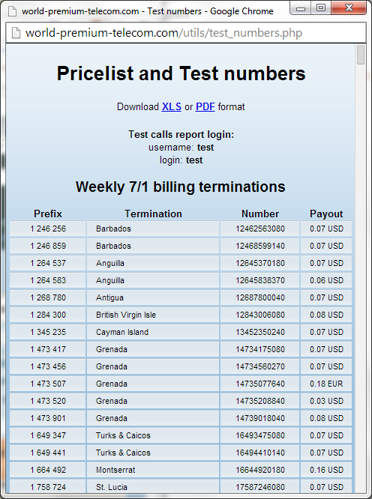
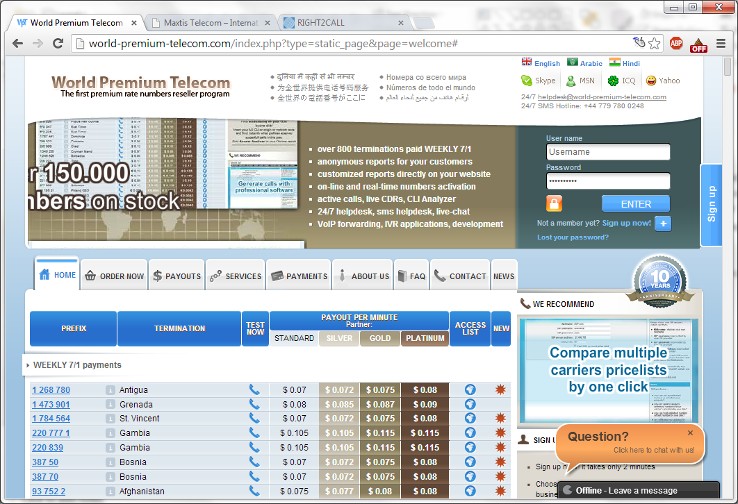
International Revenue Sharing Fraud
Joe registers a Premium Rate Service number in another country, including IVR services that can answer his calls.
Notes:
You get a number to drive calls to and a share of profit per minute
Note the test number. This is one of the first ones you’ll see going out your network

Slide 40
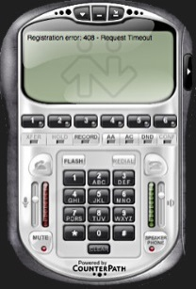

International Revenue Sharing Fraud
Joe may hide his IP via proxy, Tor, shell server, etc. but in many cases NOT
Using a cracked PBX extension, Joe makes test calls with a soft client or soft client API to make sure he can complete calls
Joe generates calls using Asterisk script, SIPp, sipcli, soft client API, etc
Joe gets paid by the PRS provider once a week (acquire nunchucks)
Joe uses the PBX for a weekend and moves on to a new one
Internet
PSTN
PRS Provider IVR

Slide 41
Wholesale Fraud / Toll Bypass
Joe hears that Tor isn’t anonymous anymore, so he doesn’t want to risk making calls and getting caught.
He decides to sell access to the PBXes he’s already cracked to someone else to carry international minutes between carriers.
Most of the money, and none of the headache
Internet
Corporate IP Network
PSTN
New SIP Trunk
SIP Trunk
IVR
Notes:
Call routing sold on exchange where players remain anonymous
http://www.billingworld.com/articles/2000/09/bandwidth-and-minutes-exchange-rating-billing-and.aspx
Fraudster uses compromised system to forward traffic between two valid service providers for attractive rates, usually advertised on wholesale marketplace websites
Revenue paid to fraudster by operators who route calls to the fraudulent trunk; Paid daily or weekly, valid subscriber billed monthly
Wholesale providers provide transit capabilities to other operators and networks
▪So these organizations have no consumer customers only provide services to other carriers
–This mean that normal service providers do not need to have interconnection points with every destination around the world
▪The wholesale networks provide the backbone for international calling services
▪The wholesale carrier can only see transit traffic; Typically, no local traffic of carriers, no customer details, partial call data records are available to them

Slide 42
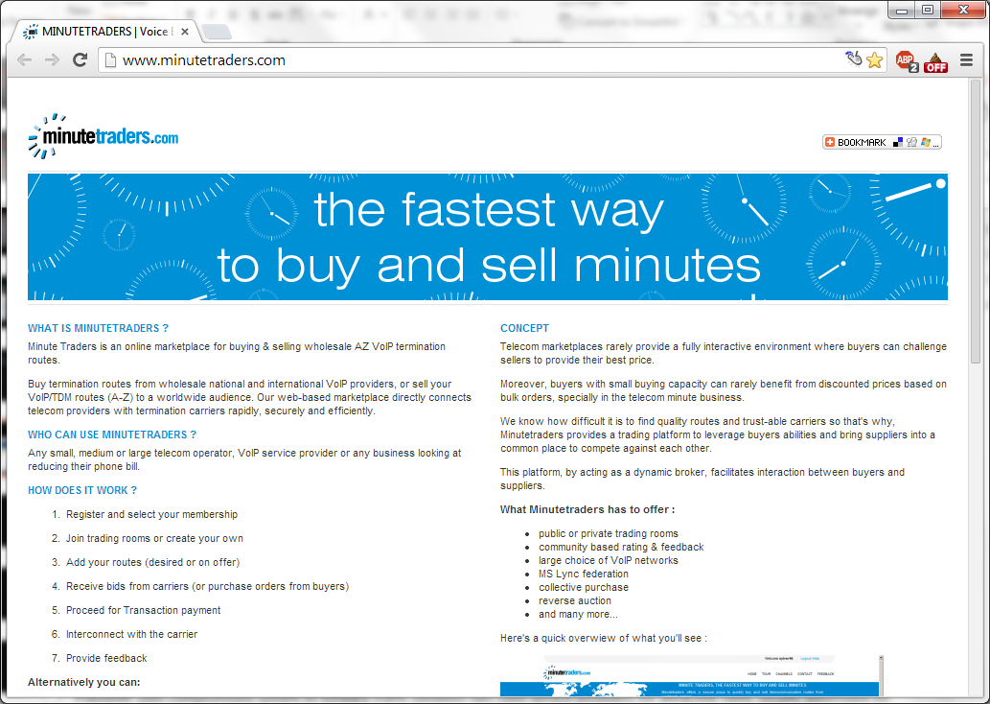
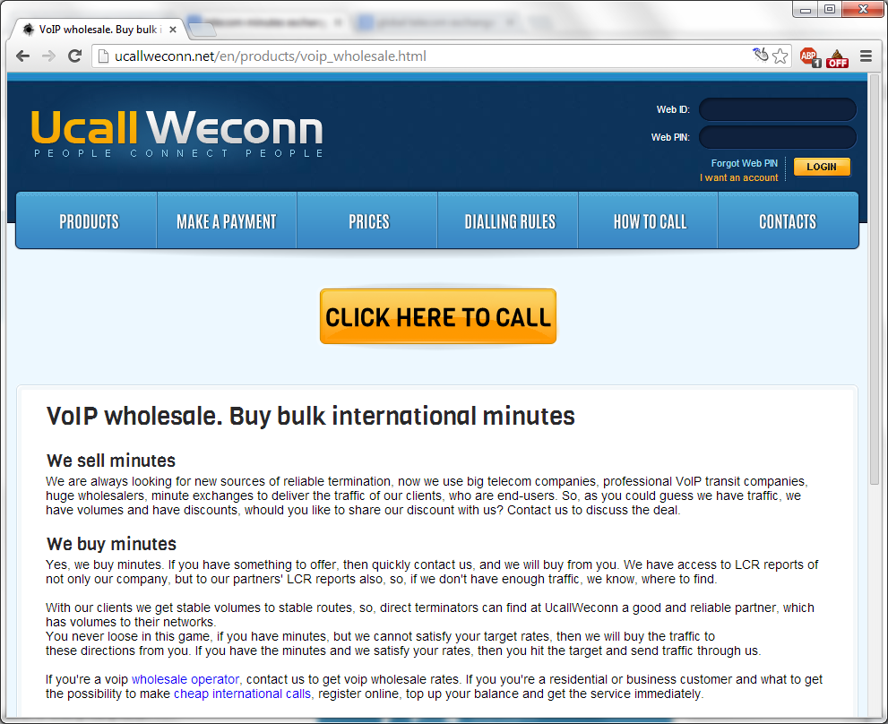
Wholesale Fraud / Toll Bypass
After a few Google searches, Joe signs up with a couple of services to sell access. These may or may not be legit, and may or may not catch him if they are.
Notes:
Wholesale providers provide transit capabilities to other operators and networks
So these organizations have no consumer customers only provide services to other carriers
This mean that normal service providers do not need to have interconnection points with every destination around the world
The wholesale networks provide the backbone for international calling services
The wholesale carrier can only see transit traffic; Typically, no local traffic of carriers, no customer details, partial call data records are available to them
He charges a rate that undercuts the regular SIP trunking providers because he doesn’t have to pay tariffs or the in-country charges for the trunks that connect to the phone network.
http://www.billingworld.com/articles/2000/09/bandwidth-and-minutes-exchange-rating-billing-and.aspx
Fraudster uses compromised system to forward traffic between two valid service providers for attractive rates, usually advertised on wholesale marketplace websites
Revenue paid to fraudster by operators who route calls to the fraudulent trunk; Paid daily or weekly, valid subscriber billed monthly

Slide 43
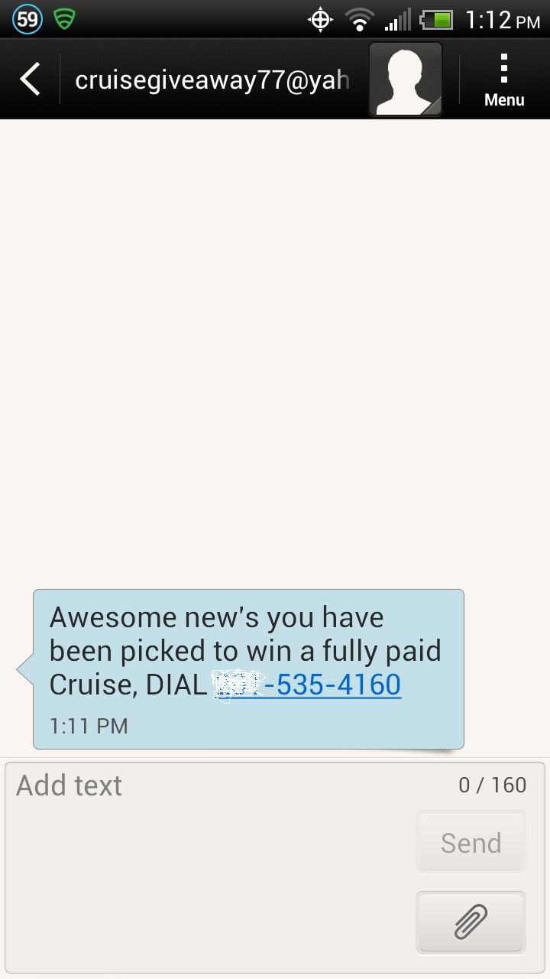
Wangiri & SMS Spam
Set up PRS number in area with prefix that looks like NANPA
Barbados 246, Antigua and Barbuda 268, BVI 284, Grenada 473, Turks and Caicos 649, Montserrat 684, Dominica 767
Wangiri – call generation script - call wide range of phones and let them ring only once. Victims call back odd number = $$
SMS Spam - script that emails SMS messages to carrier email addys (throttle required!). Victims call number or click a link.

Slide 44
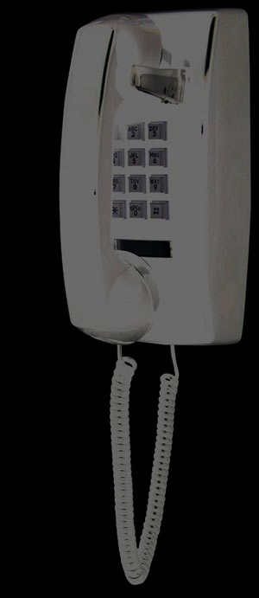
Telephony DoS (TDoS) and Extortion
Joe has a friend who works at the local check cashing center steal a list of customers who are behind on their loan. He calls and threatens to tie up the phone lines at their employer if they don’t send money to his PayPal account.
Flood of real calls that tie up a line or phone system; Usually spoofed origination
Blocking difficult in network of trusted service provider peers. Can’t block w/ACLs or firewall rules.
“Payday scams” most common
Notes:
Threats and extortion against individuals with an outstanding loan during business hours, to business number
Loan information purchased from Internet forum
May be coupled with fake call to police to nearby address
Manually conducted using a cheap labor pool

Slide 45
Call generation – option 1
Use SIPp REGISTER-INVITE scenario
http://tomeko.net/other/sipp/sipp_cheatsheet.php?lang=en
Use multiple cracked user credentials for registration
Change response or wait time in scenario based on goals
Long wait after answer (IRSF)
Call and hangup after first or second SIP ring message (Wangiri)
Wait for answer (TDoS)
Play audio on answer (?)

Slide 46
Call generation – option 2 (2600 version)
Refer to Spring 2014 edition (Vol 31, #1), Nick “MasterChen” Rosario
Set up AsteriskNOW or other Asterisk variant
Configure SIP trunk using cracked credentials (peer details & registered user)
Write shell script that creates “.call” files in /var/spool/asterisk/outgoing (owned by ‘asterisk’ user)
Channel: SIP/trunkname/<number here>
CallerID: 9195551212
MaxRetries: 5
RetryTime: 2
Context: outgoing
Extension: 9195551212
Priority: 1
Research note: Google Voice trunks are rate limited and will no-answer or send hangups (SIP CANCEL).

Slide 47
SIPp Scenario Example
<recv response="401" auth="true">
</recv>
<send retrans="500">
<![CDATA[
REGISTER sip:[remote_ip] SIP/2.0
Via: SIP/2.0/[transport] [local_ip]:[local_port];branch=[branch]
From: <sip:[field0]@[field1]>;tag=[call_number]
To: <sip:[field0]@[field1]>
Call-ID: [call_id]
CSeq: [cseq] REGISTER
Contact: sip:[field0]@[local_ip]:[local_port]
[field2]
Max-Forwards: 10
Expires: 120
User-Agent: SIPp/Win32
Content-Length: 0
]]>
</send>
Demo Time

Slide 48
And that is how Joe gets rich quick

Slide 49

https://github.com/unregistered436/Skytalks

